Slide 1

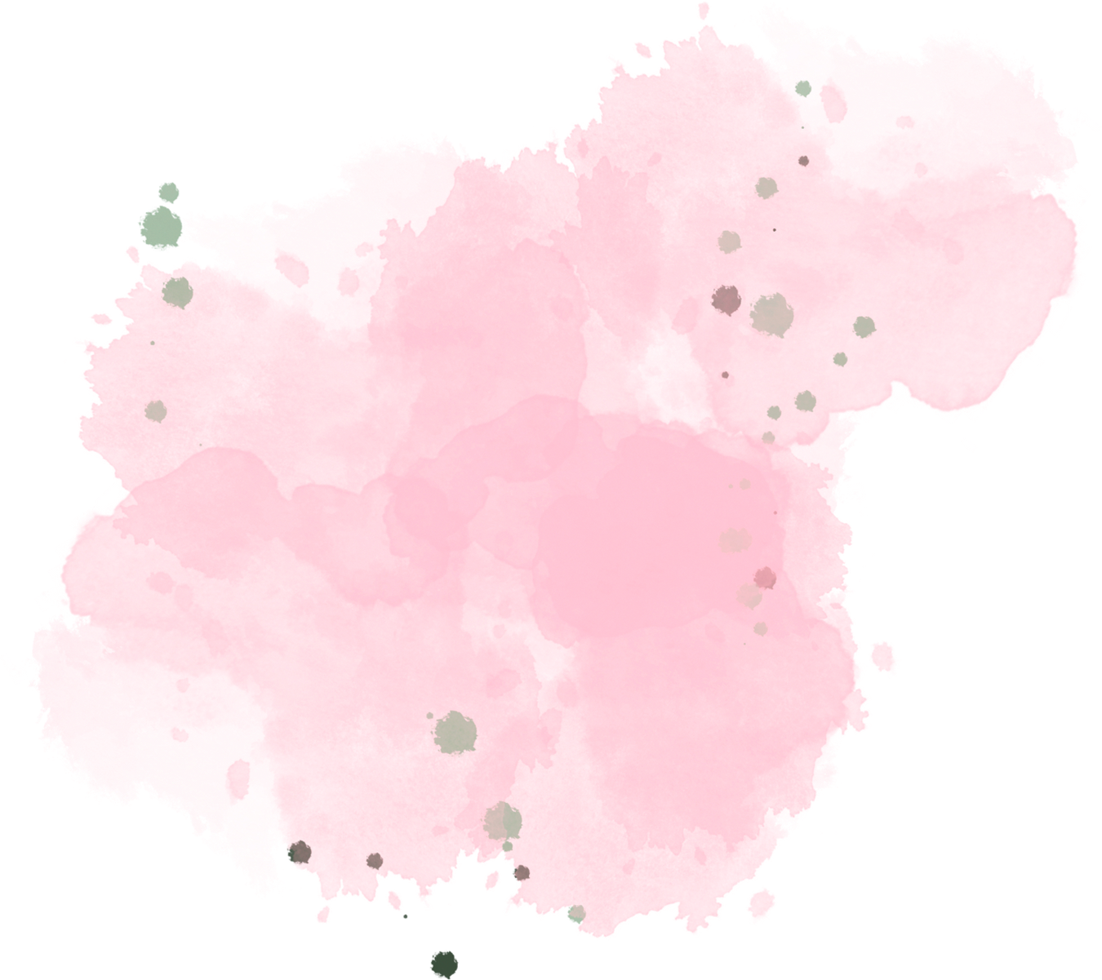
PAINT APPLICATION
Team Members:
Abirami M (9517202109003)
Bhuvanika S (9517202109011)
Rajakumari S (9517202109042)
Suji S (9517202109051)

Slide 2

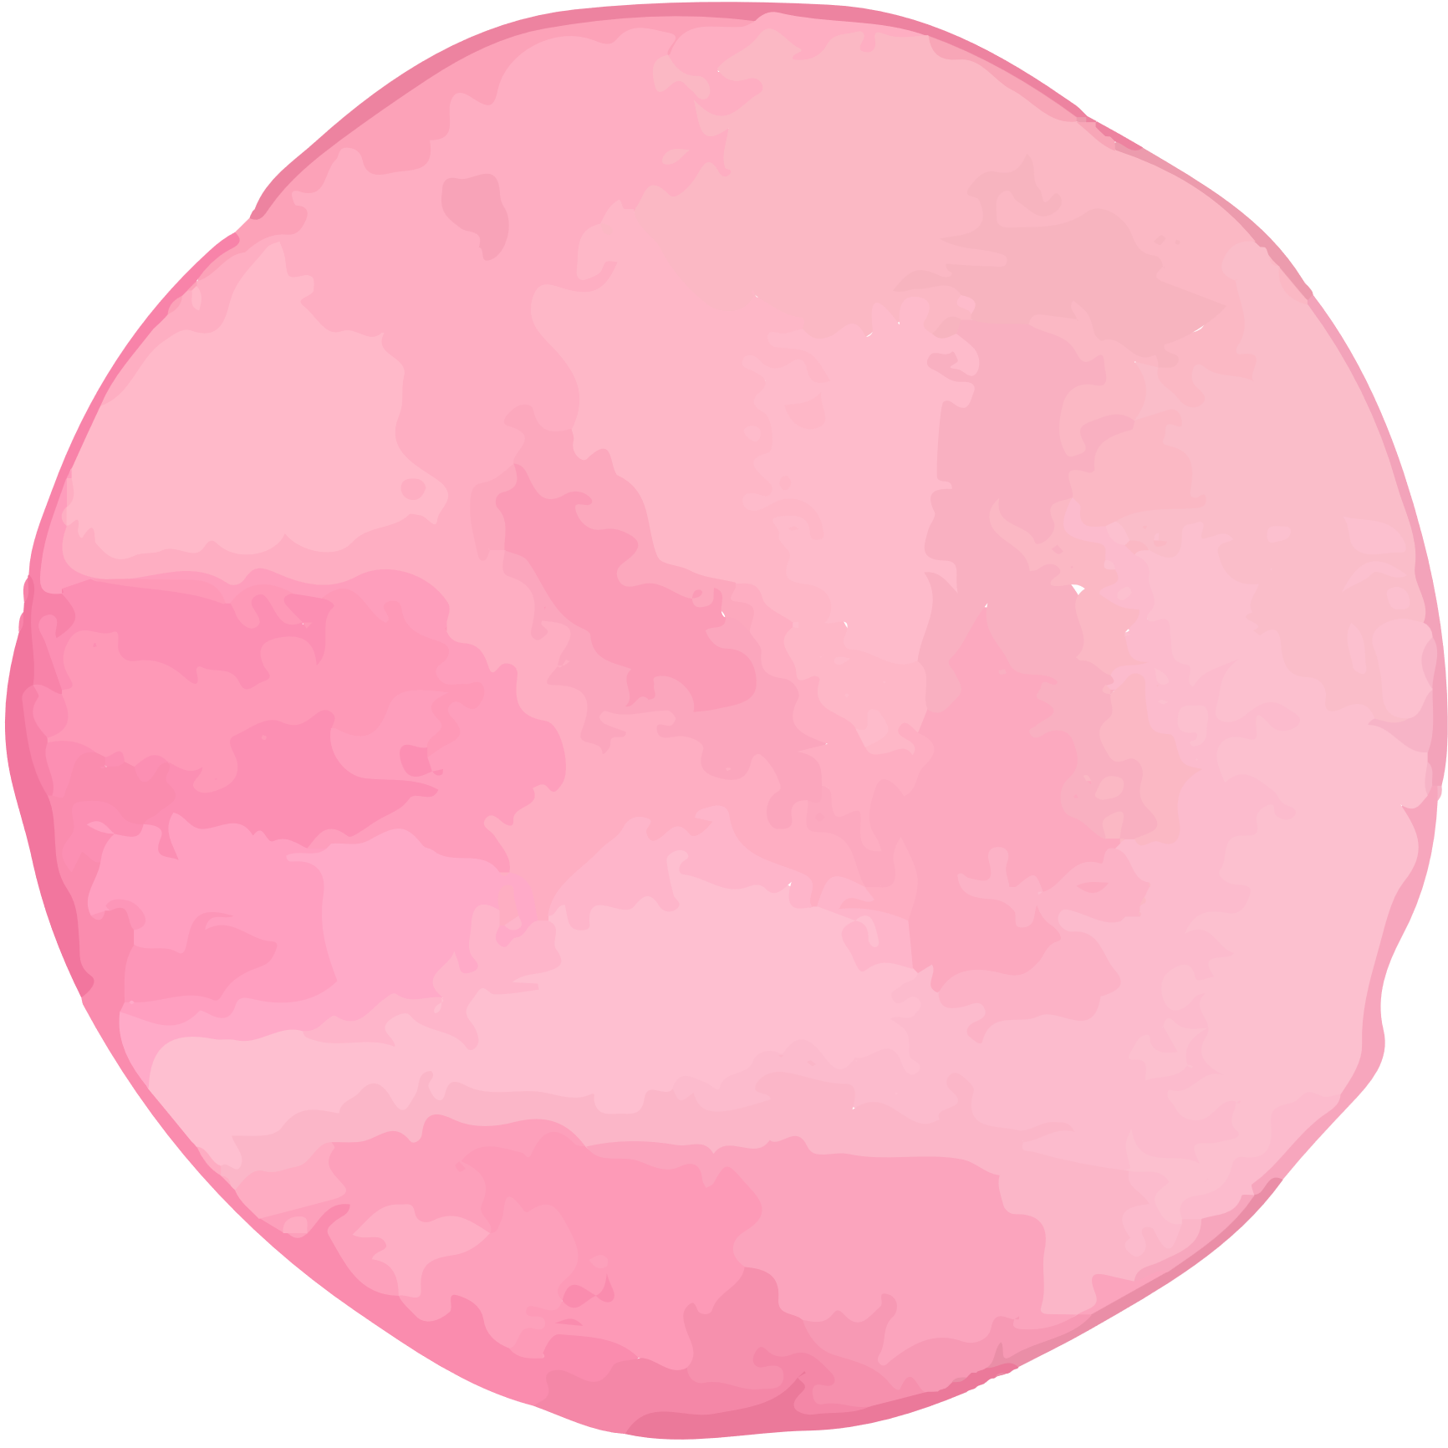

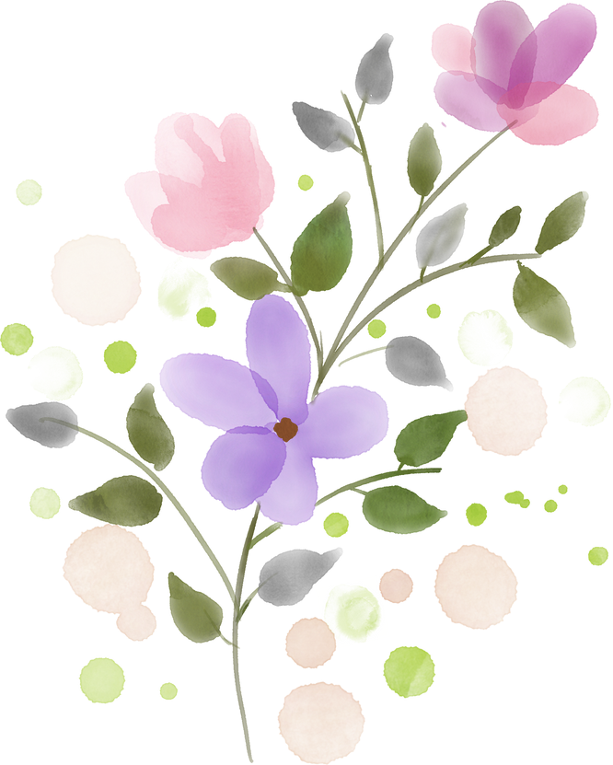
1
Aim
2
Abstract
3
Objective
Index
4
Sample Output
5
Conclusion

Slide 3

Aim
The purpose of the paint application system is to provide a user-friendly platform for children and to explore their interests through digital painting. This aims to offer a variety of tools and features, allowing them to experiment with colors, shapes, and textures in a playful environment. The scope of this product includes the development of a standalone application or web-based tool specifically designed for children aged , offering features such as drawing tools, color palettes, and save options.

Slide 4
Abstract
This project involves developing a paint application using React for building user interfaces. The application offers users a straightforward platform for creating digital art and illustrations. It features a drawing canvas, various customizable brush width, color selection options, and the ability to save and export artwork.
The paint application encourages imaginative expression and fosters a sense of accomplishment as children bring their colorful creations to life within the structured framework of the grid. Overall, it provides a fun and educational platform for children to explore the world of digital art through a playful and interactive color-by-number experience.

Slide 5
Objective
The objective of this project is to develop a paint application using a React app with distinct modules catering to both kids and teens, providing age-appropriate features and functionalities.
For the kids module, the objective is to create an engaging and interactive platform where children can develop their cognitive skills through coloring activities. Specifically, children can color a number matrix to reveal an image, fostering creativity and numerical comprehension.
The teen module aims to offer a comprehensive canvas-based painting tool that empowers teenagers to express their creativity through various means. This includes filling colors, adding shapes, freehand drawing, erasing, text input, and customization options for shape and pen size and color. Additionally, users will have the capability to save their creations as PNG files, allowing them to preserve and share their artwork effortlessly.
Overall, the objective is to provide a versatile paint application that caters to the diverse needs and interests of both kids and teens.

Slide 6
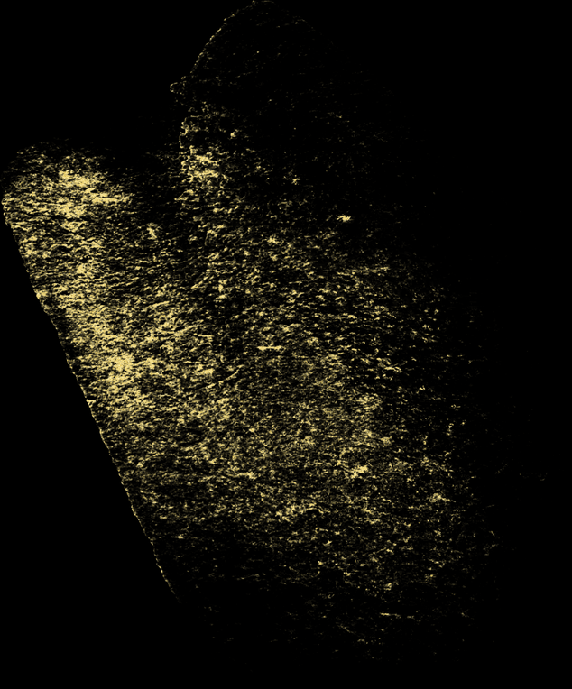
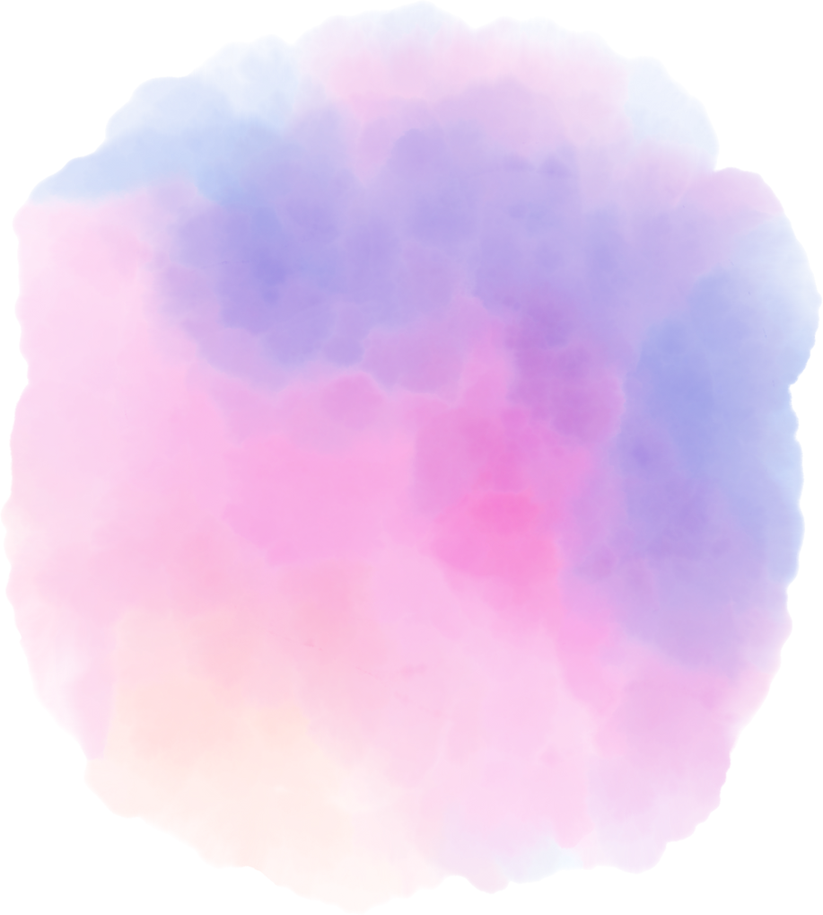
Sample Output

Slide 7
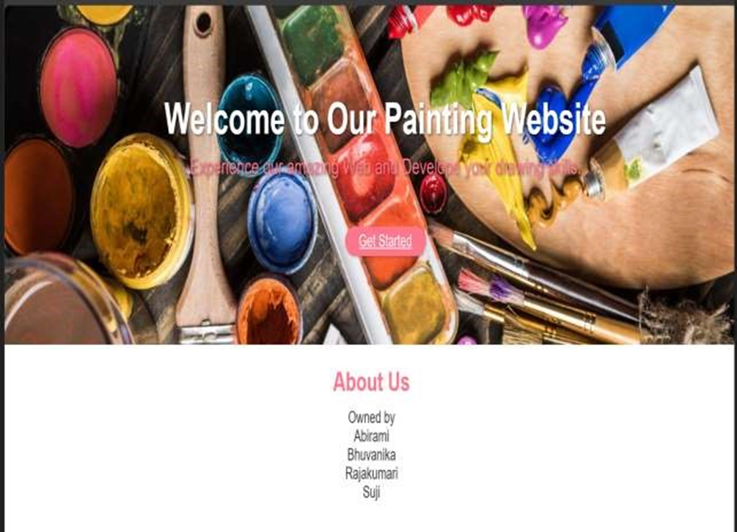

Slide 8
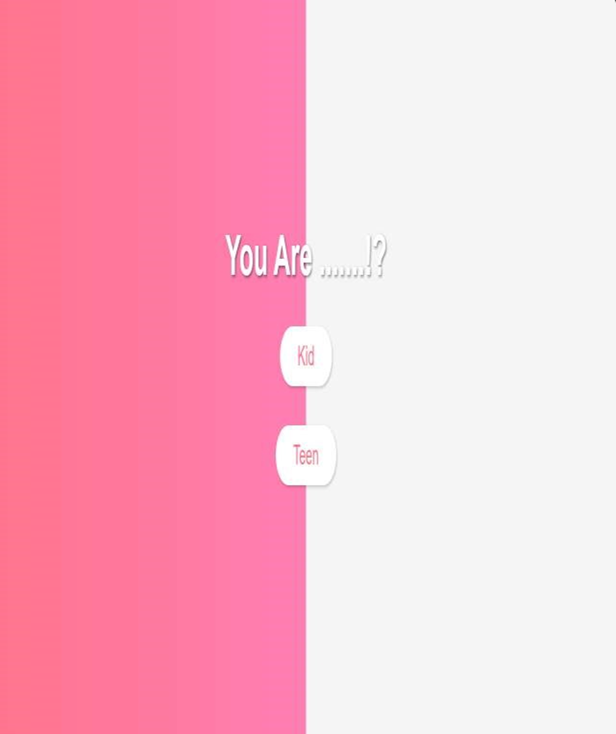

Slide 9


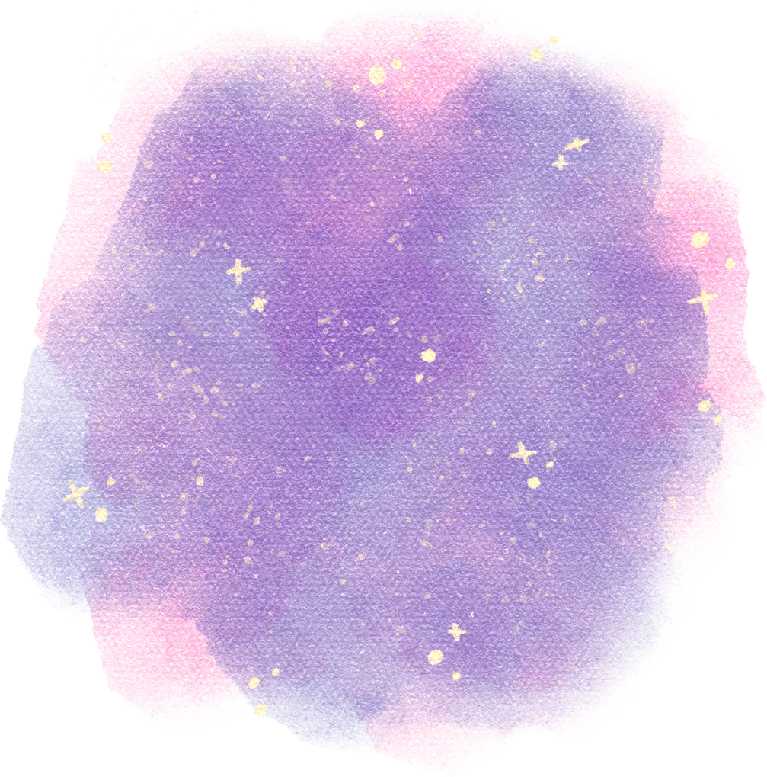
Teen Module

Slide 10
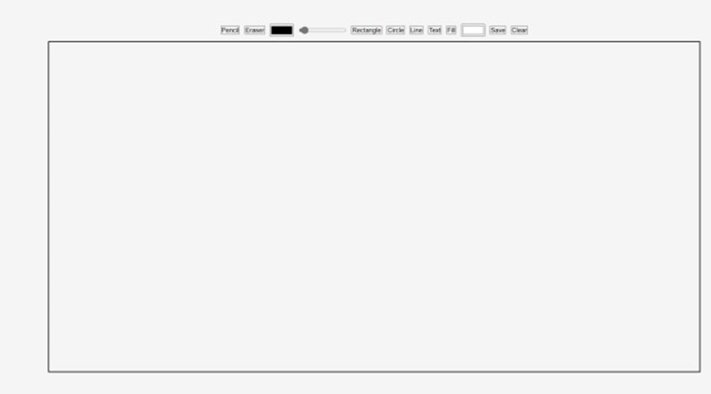

Slide 11
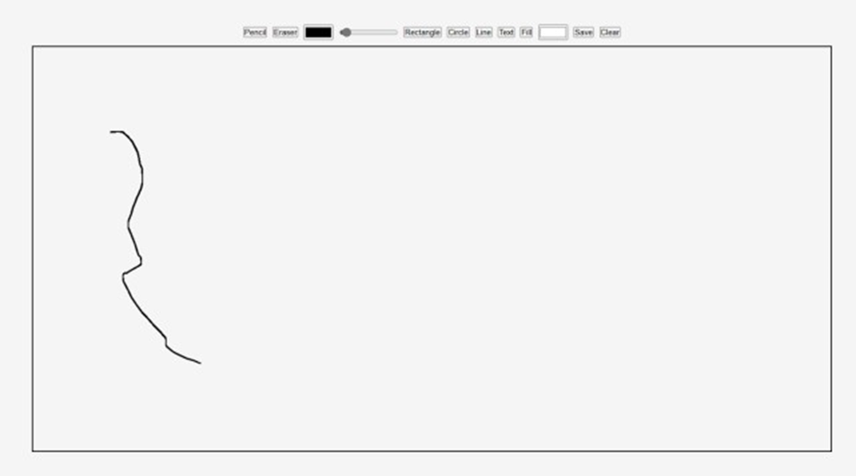

Slide 12
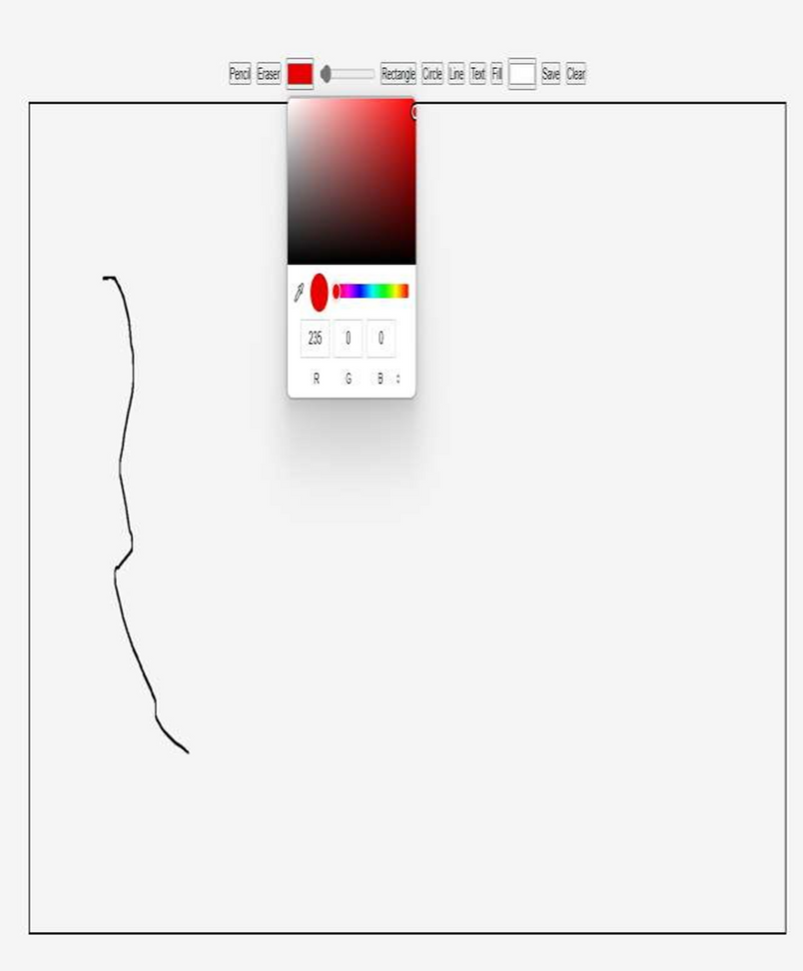

Slide 13
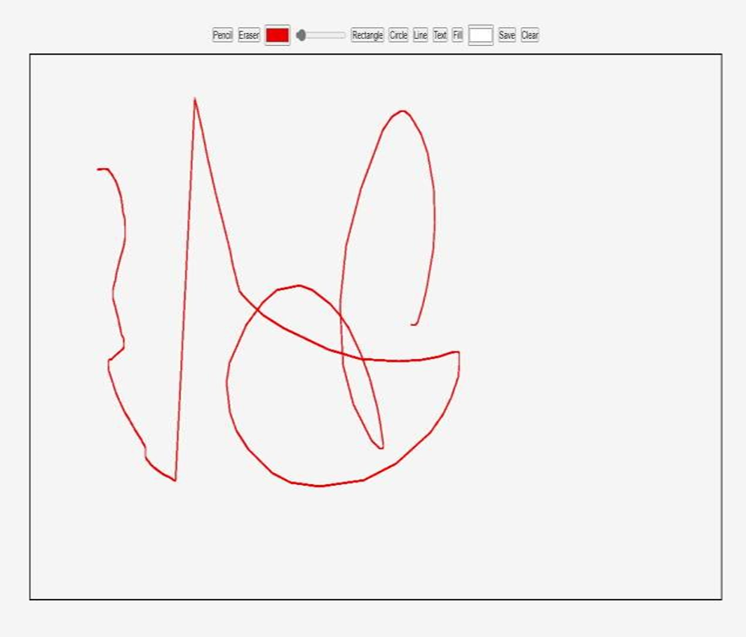

Slide 14
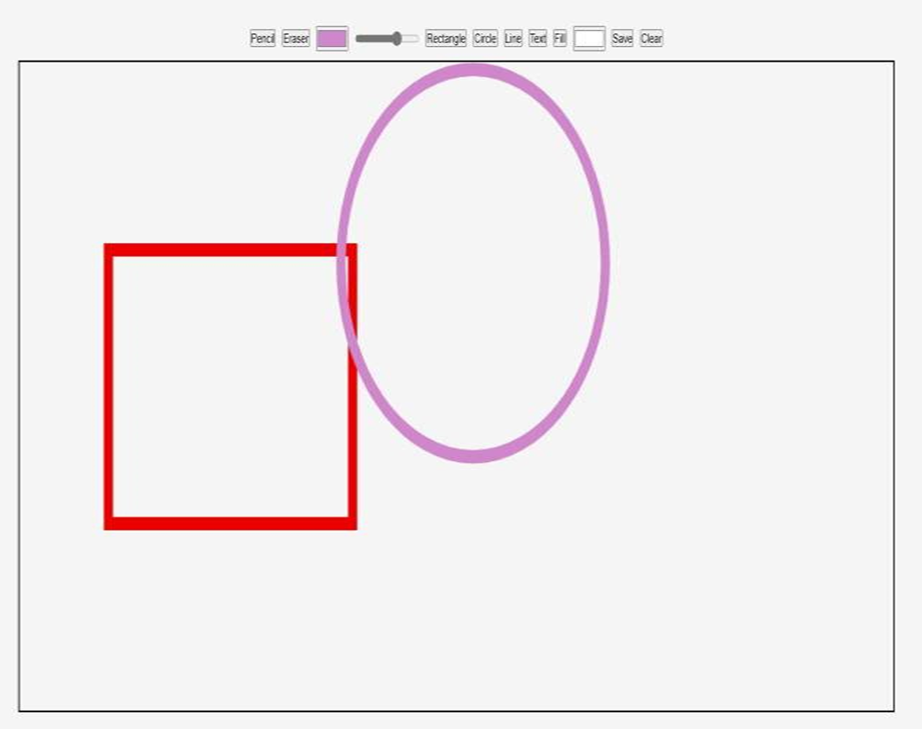

Slide 15
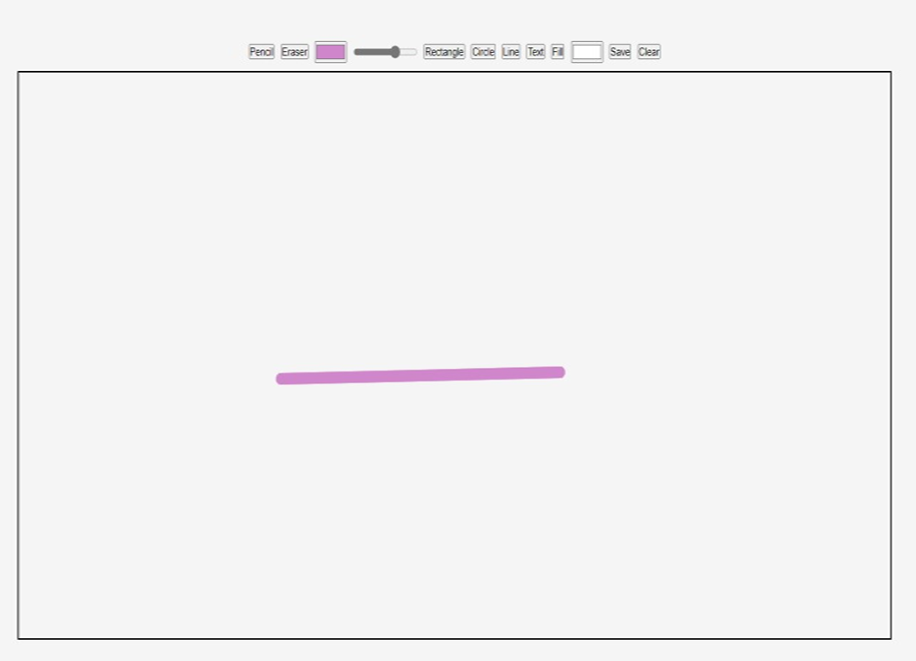

Slide 16
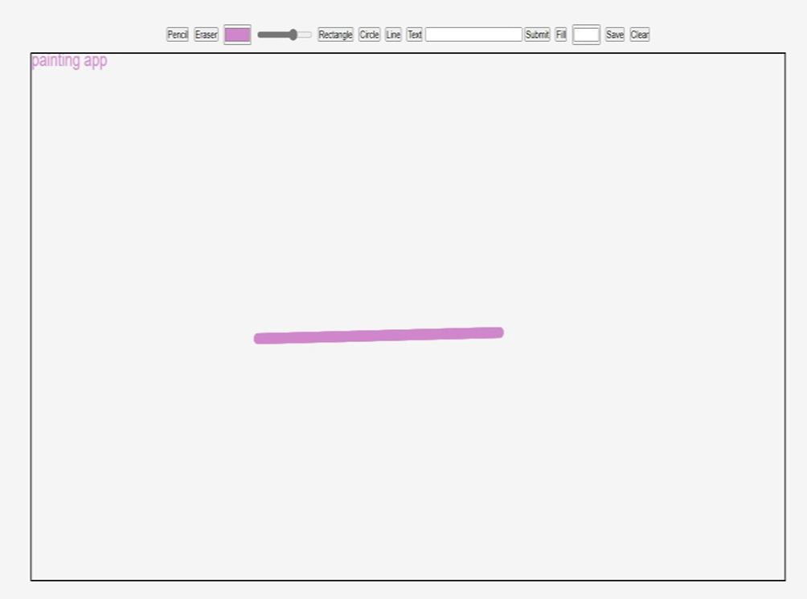

Slide 17
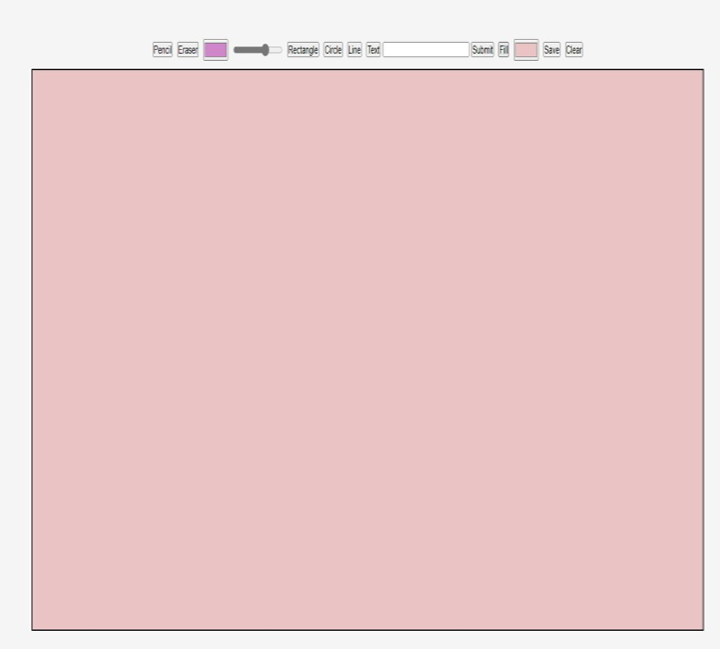

Slide 18
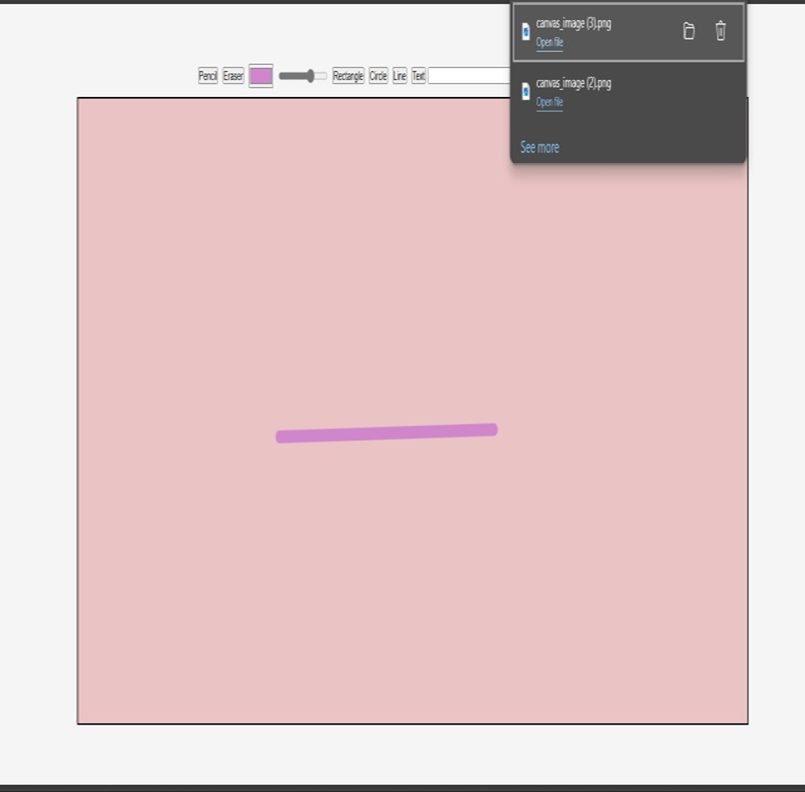

Slide 19
Kids Module

Slide 20
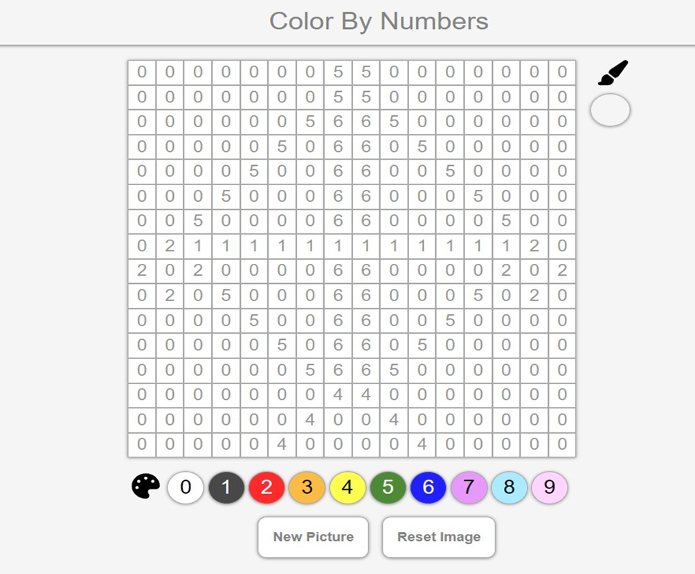

Slide 21
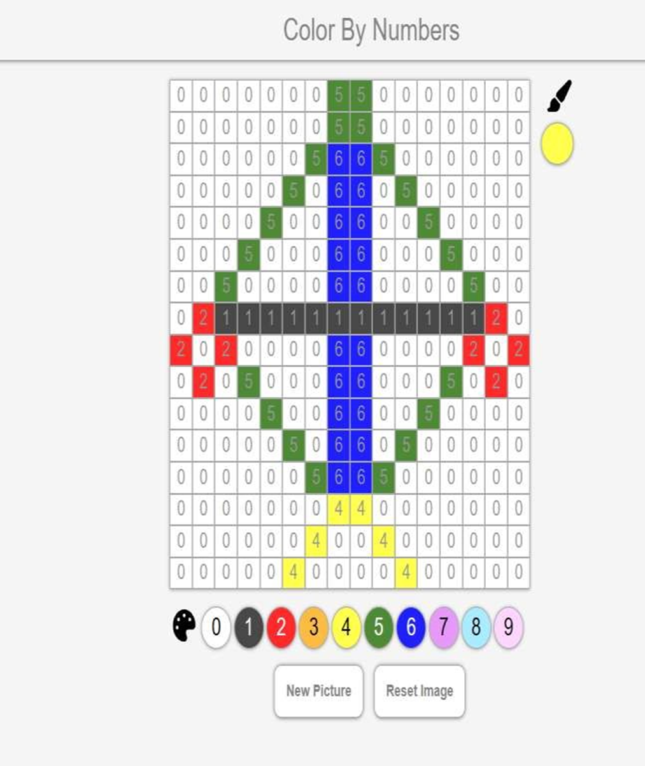

Slide 22
Conclusion
The React-based paint application, comprising distinct modules for kids and teens, revolutionizes digital art engagement. The kids' module offers a simplified yet enjoyable experience, fostering creativity through activities like coloring number matrices. Conversely, the teen module provides a comprehensive suite of tools for artistic expression, including coloring, shape creation, drawing, and text insertion, coupled with customization options. Both modules enable users to save their creations as PNG files. This application serves as a versatile and interactive platform for children and teenagers to explore their creativity, enhance cognitive skills, and express themselves artistically.

Slide 23
Thank You

